Slide 1




HOSPITAL WEBSITE
LJ Institute Of Engineering And Technology
Caring Hands, Healing Hearts.

Slide 2
HOSPITAL WEBSITE
Name :- Satasiya Daksh M.
Roll No. :- 24
Enrollment :- 23002170110165
No.
Division :- A1
Branch :- C.E.
Name :- Satasiya Daksh M.
Roll No. :- 22
Enrollment :- 23002170110165
No.
Division :- A1
Branch :- C.E.
Sem :- 4th
Name :- Satasiya Daksh M.
Roll No. :- 24
Enrollment :- 23002170110165
No.
Division :- A1
Branch :- C.E.
LJ Institute Of Engineering And Technology
Caring Hands, Healing Hearts.

Slide 3



Agenda :-
2
Name :- Satasiya Daksh M.
Roll No. :- 22
Enrollment :- 23002170110165
No.
Division :- A1
Branch :- C.E.
Sem :- 4th
Introduction
Functionality
Merits
Demerits
Future Scope
…..
...………………………………………………………………………………………………………………………………………......

Slide 4












4
Agenda :-
An online hospital website helps people take care of their health from the comfort of their homes. It allows patients to book appointments, contact doctors, and access medical information by one click.
Introduction
Functionality
Merits
Demerits
Future Scope
Name :- Satasiya Daksh M.
Roll No. :- 22
Enrollment :- 23002170110165
No.
Division :- A1
Branch :- C.E.
Sem :- 4th
Our hospital website is designed to make healthcare simple, efficient, and accessible.

Slide 5
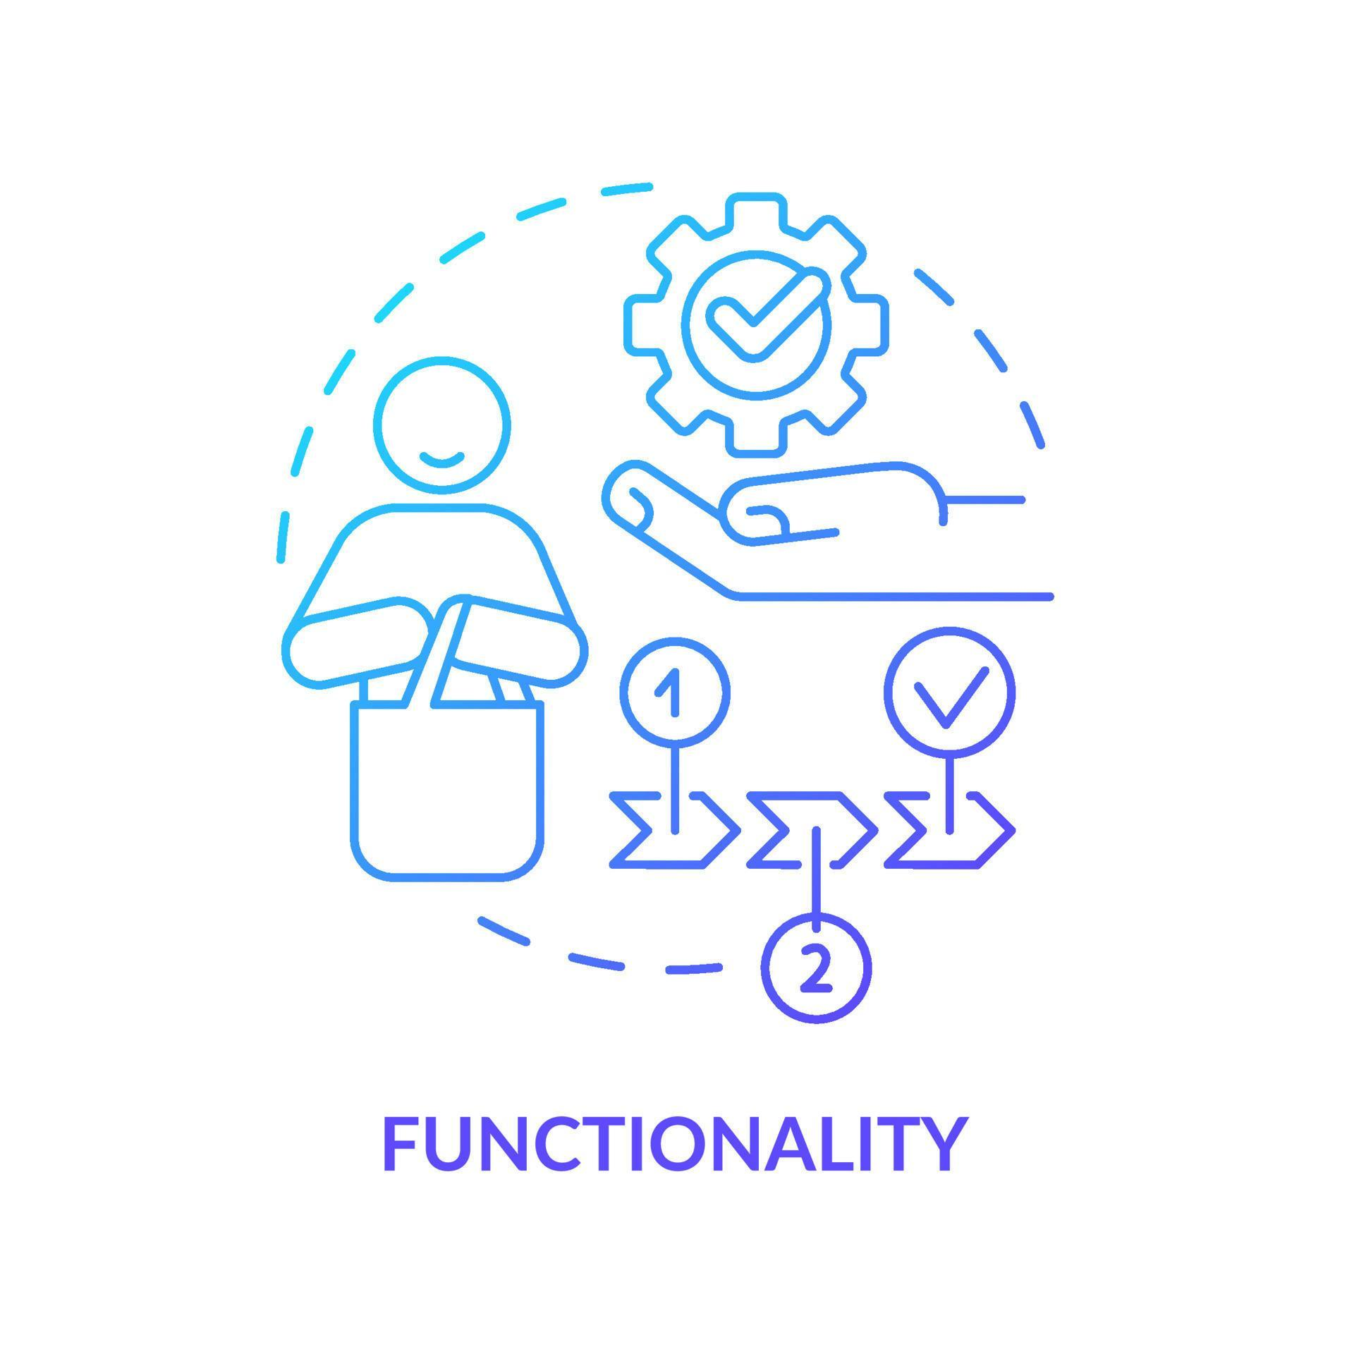
INTRODUCTION :-
Agenda :-
Functionalities
Patient can signup and login / admin can login to access patient information.
Patient can give reviews , description , rating after login to website.
Patient can book appointment after login.
Admin can accept / reject the appointment according to convivence.
Diseases info section for predict the diseases according to the symptoms and also give medicines to avoid the diseases using static json.
Successfully booking /rejecting of appointment can be mail to patient’s email.
An online hospital website helps people take care of their health from the comfort of their homes. It allows patients to book appointments, contact doctors, and access medical information by one click.
Introduction
Functionality
Merits
Demerits
Future Scope
Our hospital website is designed to make healthcare simple, efficient, and accessible.
…..
...………………………………………………………………………………………………………………………………………......
…..
...………………………………………………………………………………………………………………………………………......

Slide 6


Functionalities
5
Of hospital website :
Patients can book doctor appointments anytime, anywhere without visiting the hospital.
Patient can signup and login / admin can login to access patient information.
Patient can give reviews , description , rating after login to website.
Patient can book appointment after login.
Admin can accept / reject the appointment according to convivence.
Diseases info section for predict the diseases according to the symptoms and also give medicines to avoid the diseases using static json.
Successfully booking /rejecting of appointment can be mail to patient’s email.
Patients can access information about services, doctors, departments, and facilities anytime.
Our website can provide reviews, blogs, services.
Reduces paperwork and ensures data accuracy.
Reduces human errors in billing, scheduling, and record-keeping.
Patients can see the information about services, doctors, departments, and facilities anytime.
Our website can provide reviews, ratings, diseases prediction services.
Reduces paperwork and ensures data accuracy.

Slide 7


Merits :-
Patients can book doctor appointments anytime, anywhere without visiting the hospital.
Patients need a stable internet connection to access the email for appointment.
You have to meet the doctor after appointment.
Patients can see the information about services, doctors, departments, and facilities anytime.
Our website can provide reviews, ratings, diseases prediction services.
Reduces paperwork and ensures data accuracy.
…..
...………………………………………………………………………………………………………………………………………......
…..
...………………………………………………………………………………………………………………………………………......
Websites may experience server crashes, slow loading times, or downtime, making it inaccessible for patients.
…..
...………………………………………………………………………………………………………………………………………......
…..
...………………………………………………………………………………………………………………………………………......

Slide 8

Demerits :-
Patients need a stable internet connection to access the email for appointment.
You have to meet the doctor after appointment.
Doctor will receive real time data of regular patients for their better cure.
Virtual AI based doctor can be made for cure patient online.
Emergency cases can be booking online and then the hospital staff will come at home , no need to go for hospital.
Websites may experience server crashes, slow loading times, or downtime, making it inaccessible for patients.
…..
...………………………………………………………………………………………………………………………………………......
…..
...………………………………………………………………………………………………………………………………………......
Virtual assistants will help schedule appointments, remind patients about medications, and provide health tips.
Make the appointment for specific disease to that specific doctor.
Doctor will receive real time data of regular patients for their better cure.
Voice based appointment should be fitted like google assistant, alexa for taking appointment.

Slide 9
Future Scope :-
Thank You…
Doctor will receive real time data of regular patients for their better cure.
Virtual AI based doctor can be made for cure patient online.
Emergency cases can be booking online and then the hospital staff will come at home , no need to go for hospital.
…..
...………………………………………………………………………………………………………………………………………......
…..
...………………………………………………………………………………………………………………………………………......

Slide 10
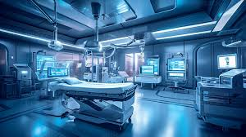
Thank You…
…..
...………………………………………………………………………………………………………………………………………......
…..
...………………………………………………………………………………………………………………………………………......
Doctor will receive real time data of regular patients for their better cure.
Virtual AI based doctor can be made for cure patient online.
Emergency cases can be booking online and then the hospital staff will come at home , no need to go for hospital.

